Slide 1
Project Logbook Plots
Tom Tyler
IIB Project
Open-source Data-driven Aerodynamic Turbine Design
(This logbook has a complimentary physical book)

Slide 2
Week 1

Slide 3
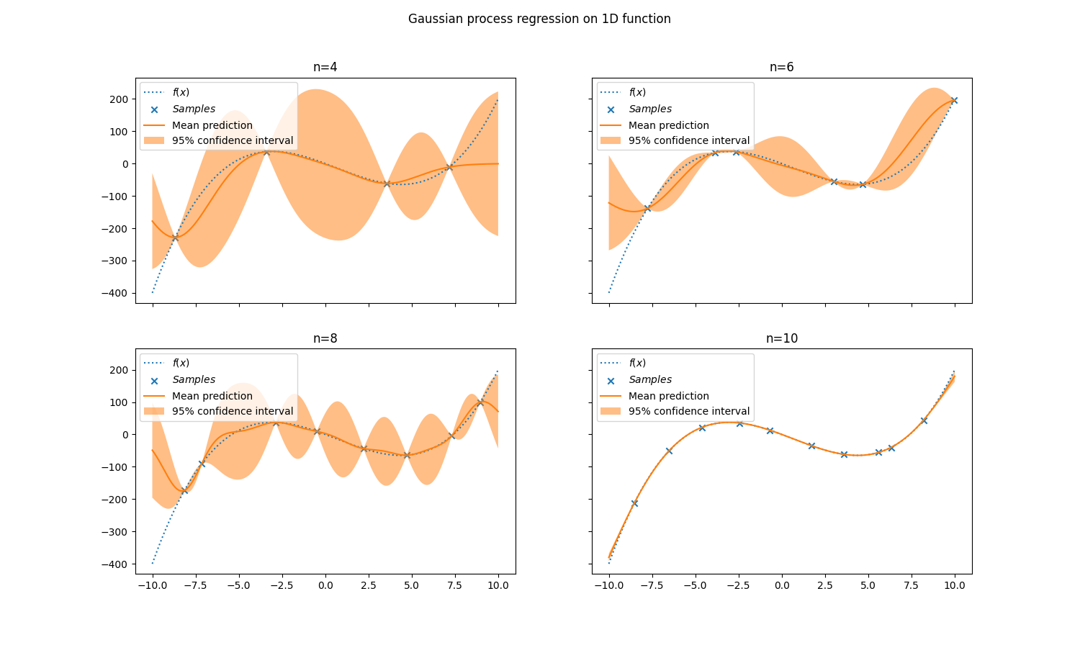
Fitting 1D Data - varying n

Slide 4
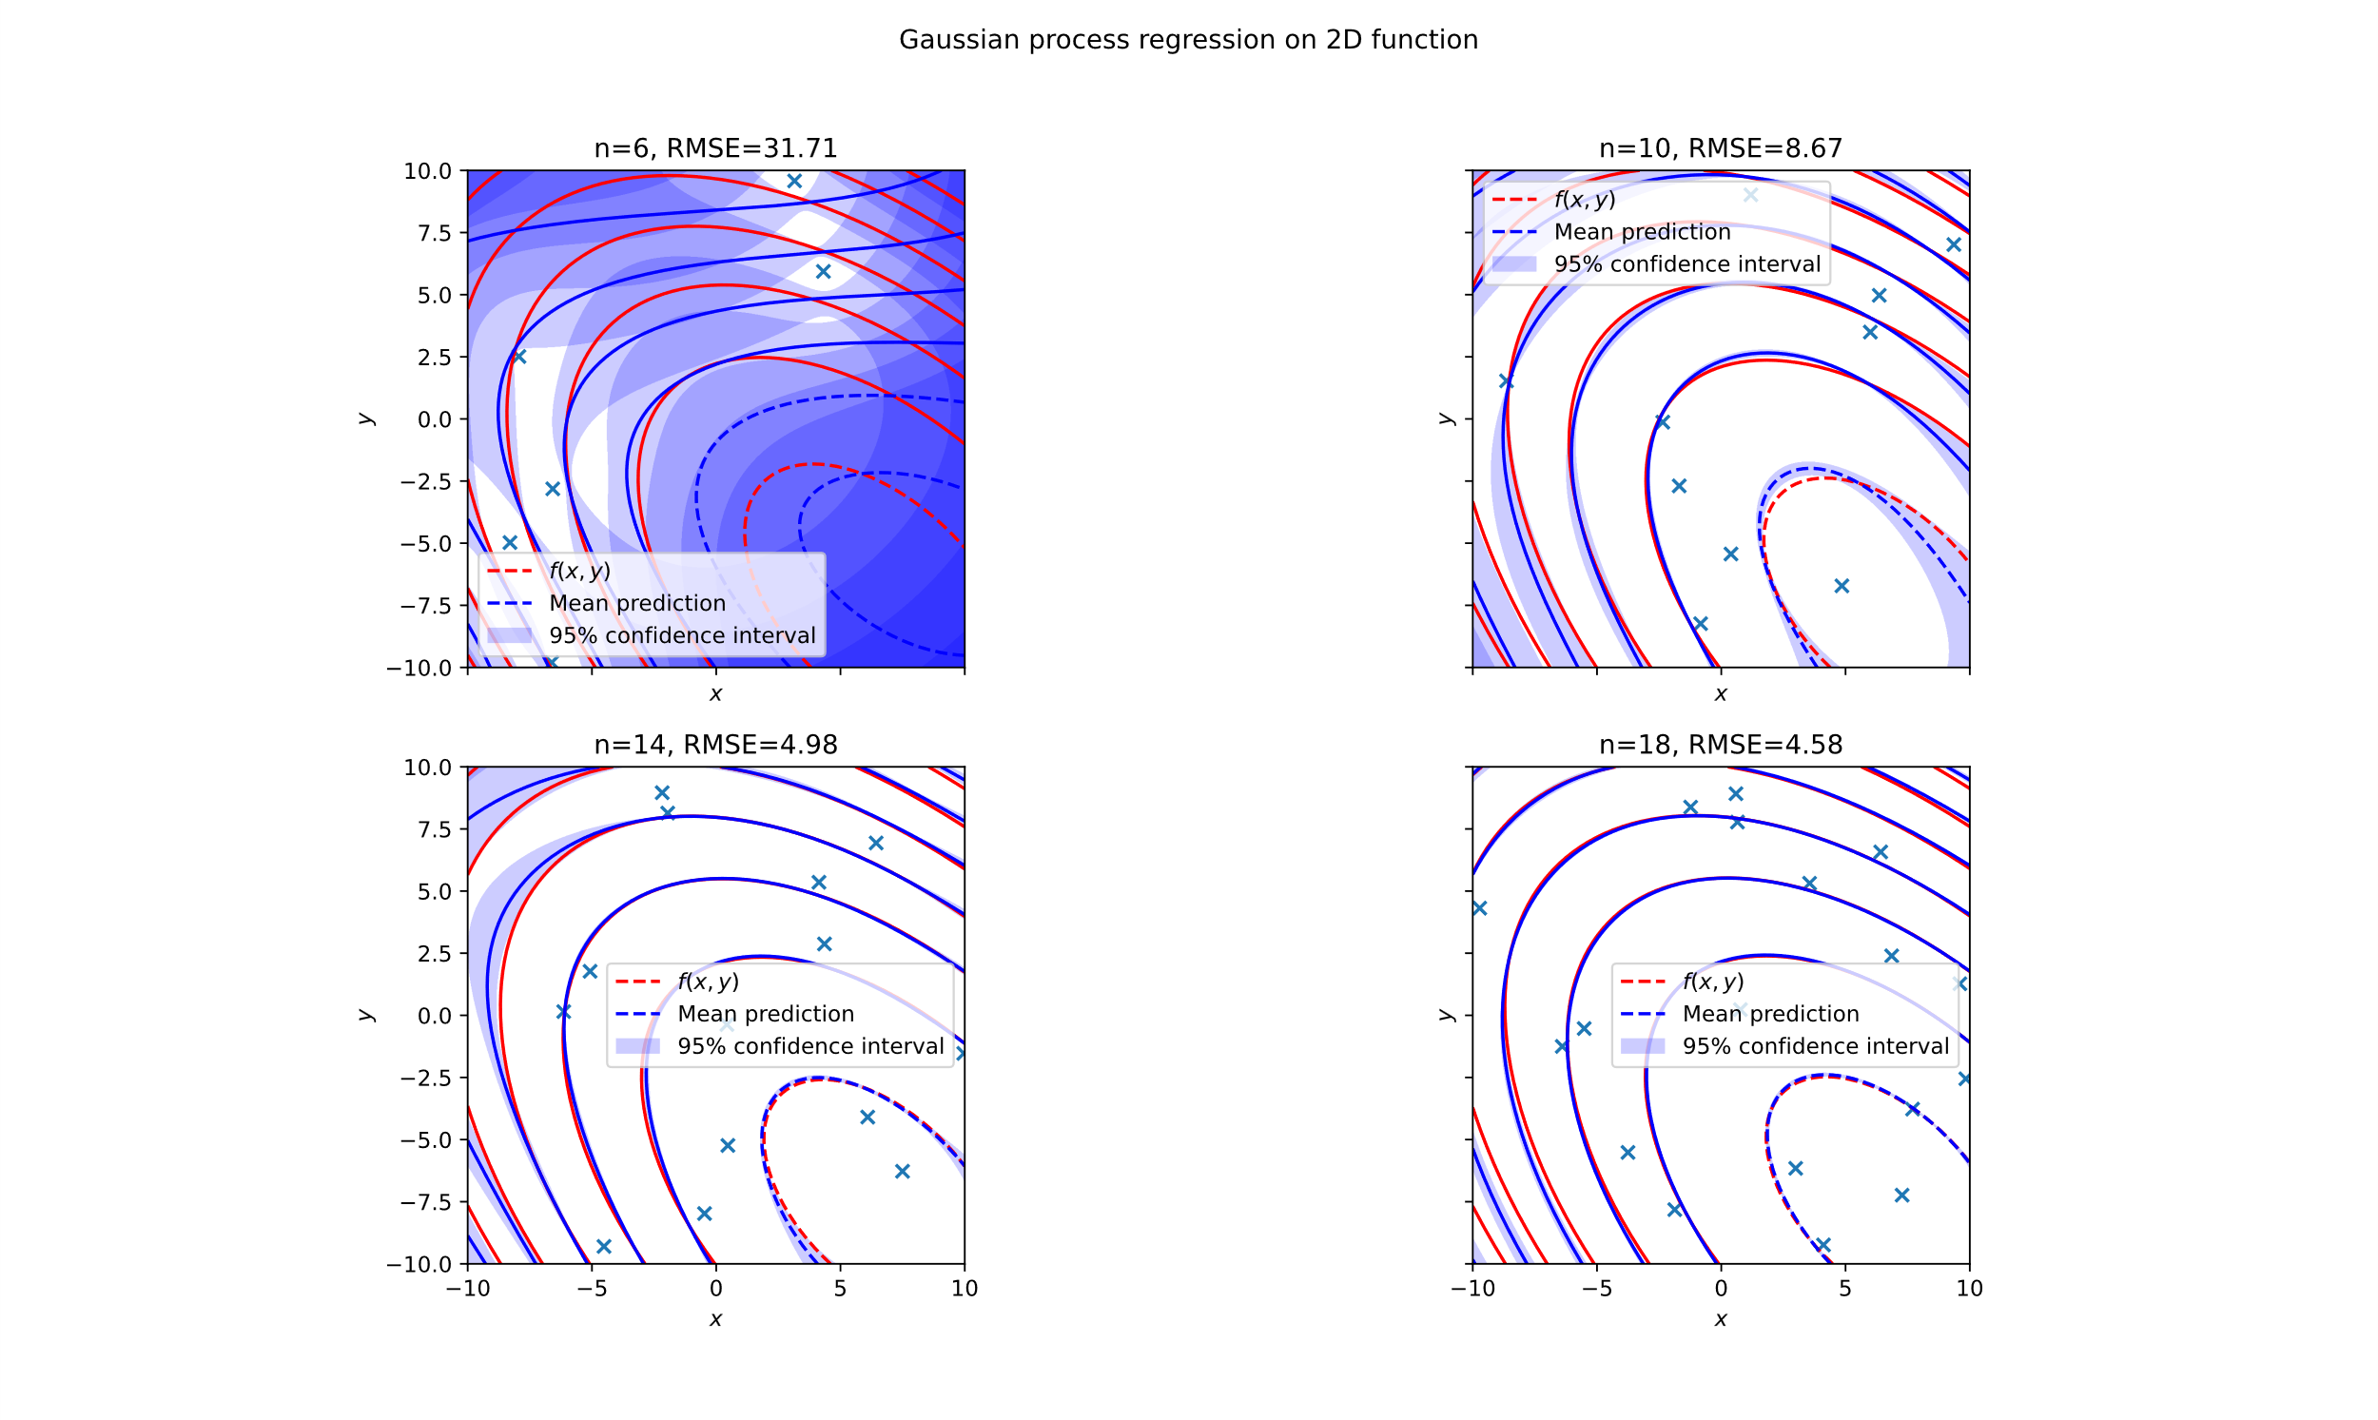
Fitting 2D Data - varying n

Slide 5
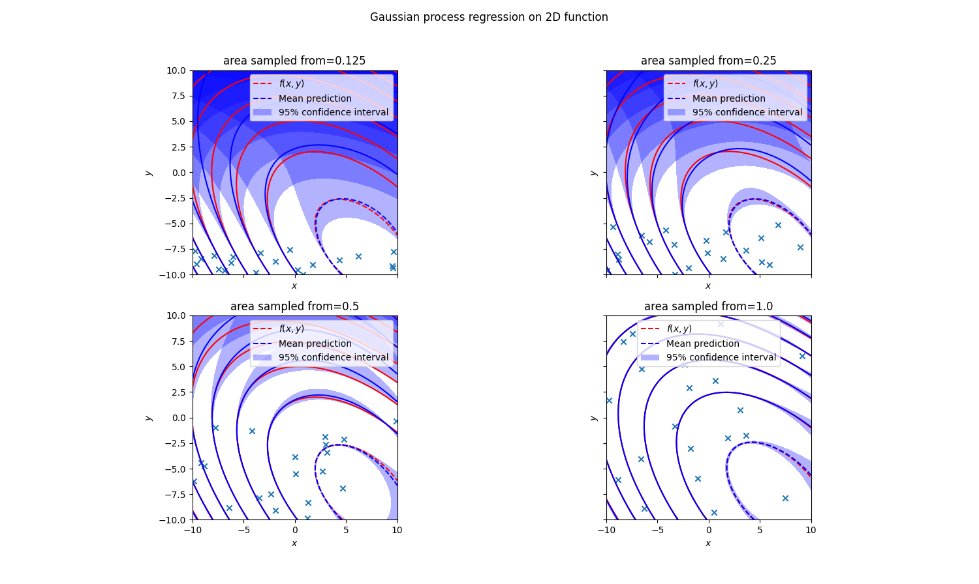
Fitting 2D data – vary space sampled from

Slide 6
Week 2

Slide 7
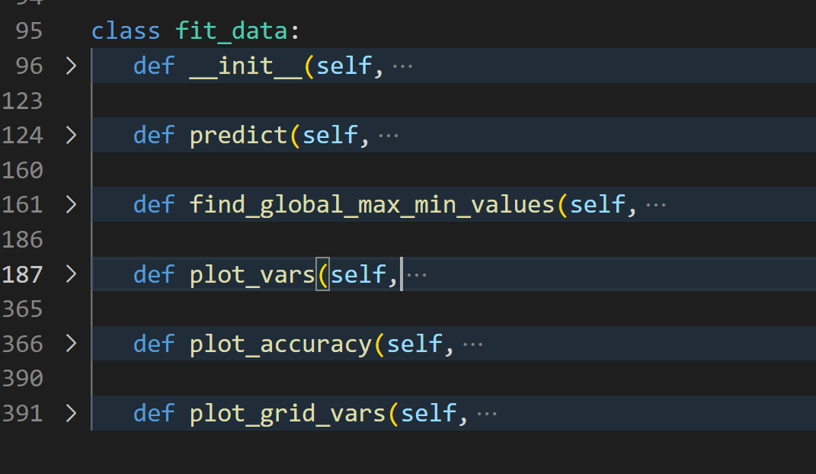
General code layout

Slide 8
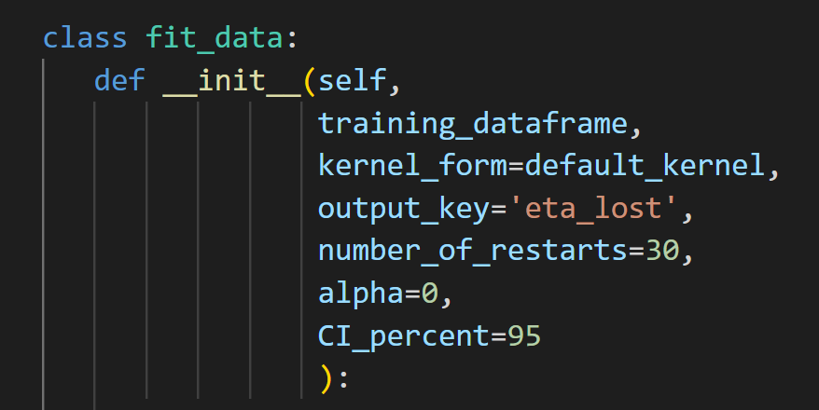
fit_data – create model

Slide 9
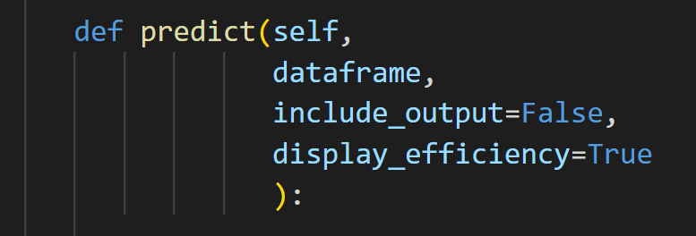
predict

Slide 10
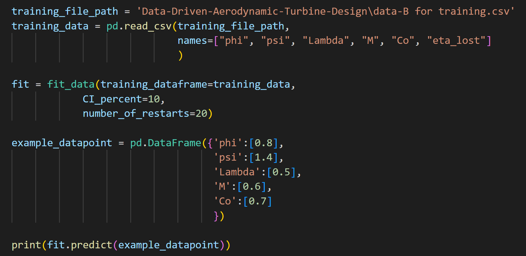
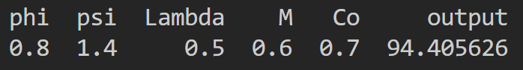
predict (example)

Slide 11
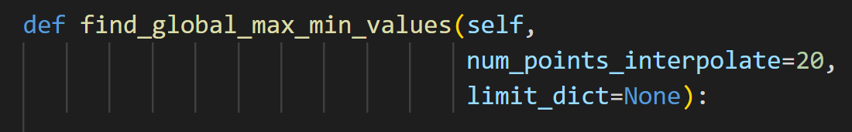
find_global_max_min_values
Number is small, as needs to find maximum value out of n⁵ data points. How can this be improved? Gradient descent? With 20, method takes 26 seconds (in debug mode)

Slide 12
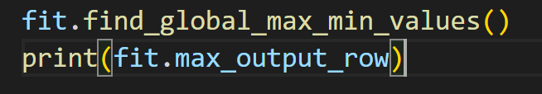
find_global_max_min_values (example)
Finds the maximum value without extrapolation

Slide 13
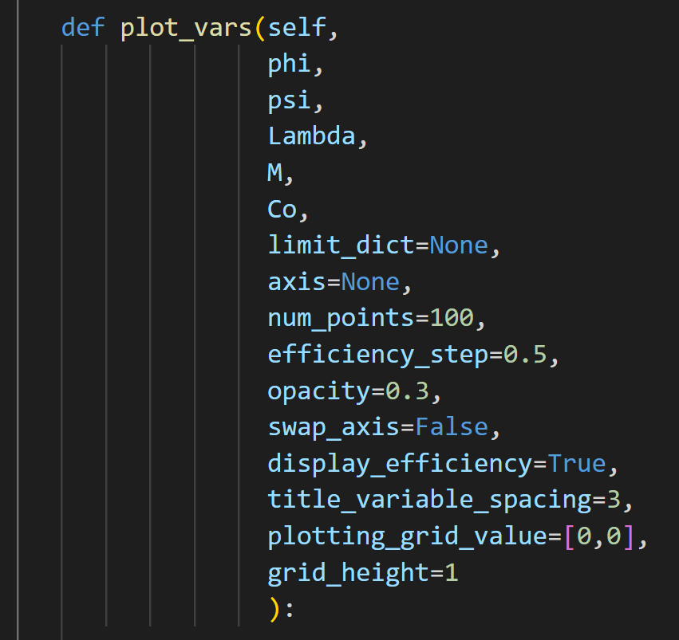
plot_vars

Slide 14
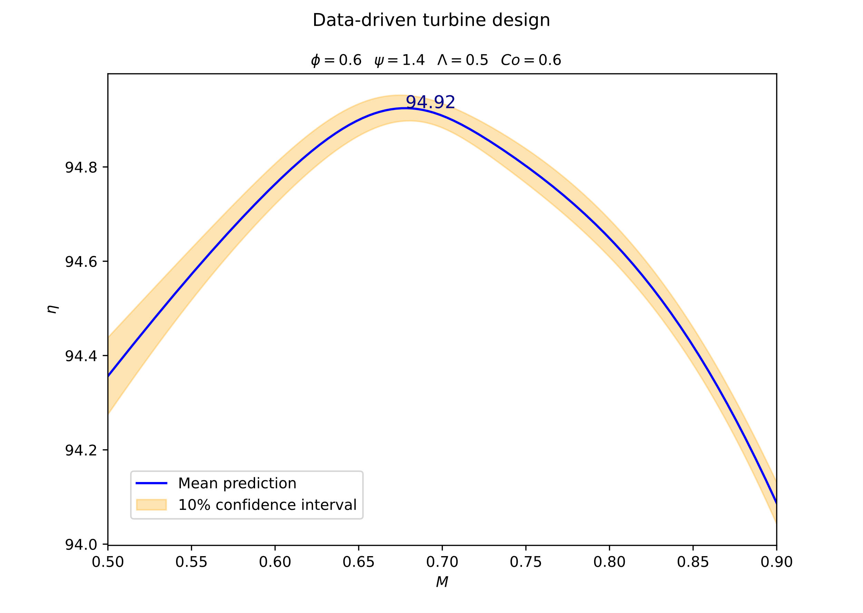
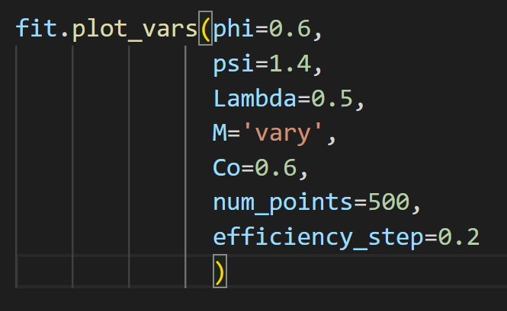
plot_vars (examples)

Slide 15
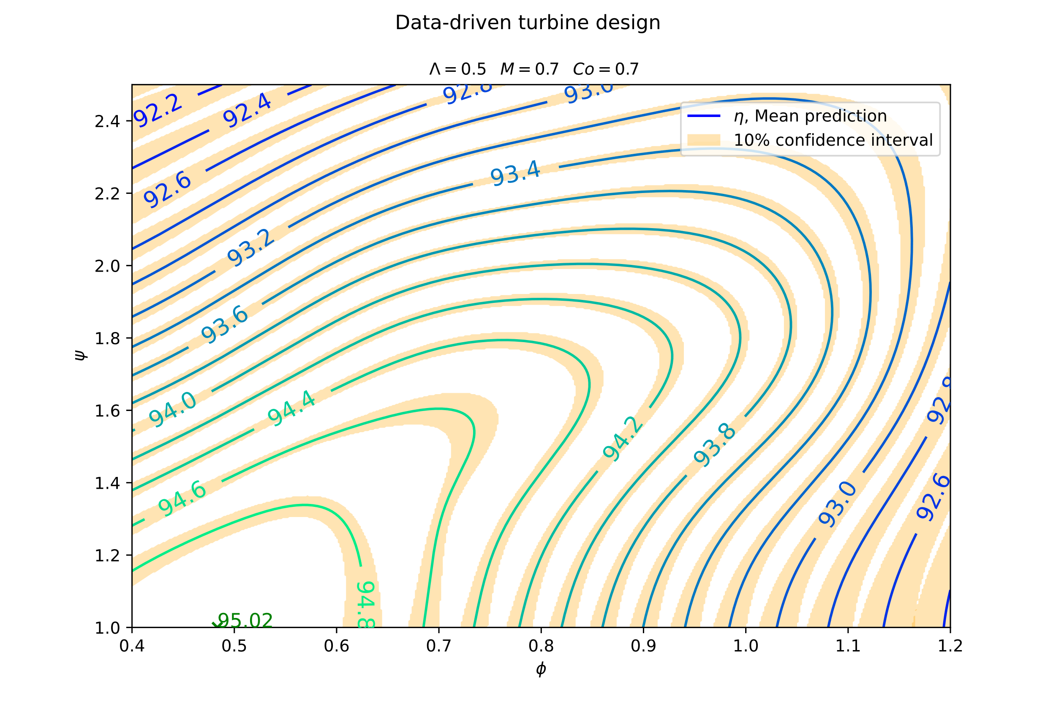
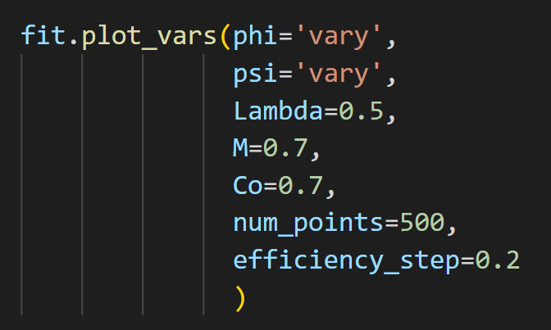
plot_vars (examples)

Slide 16
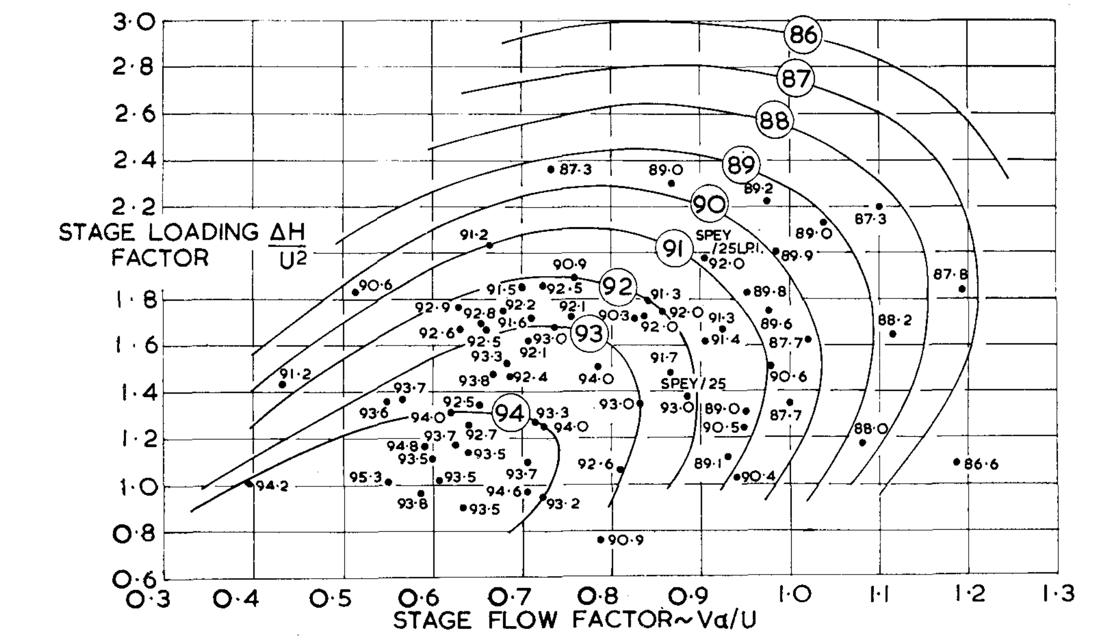
plot_vars (smith chart comparison)
Different axis
Do not know values of Co and M

Slide 17
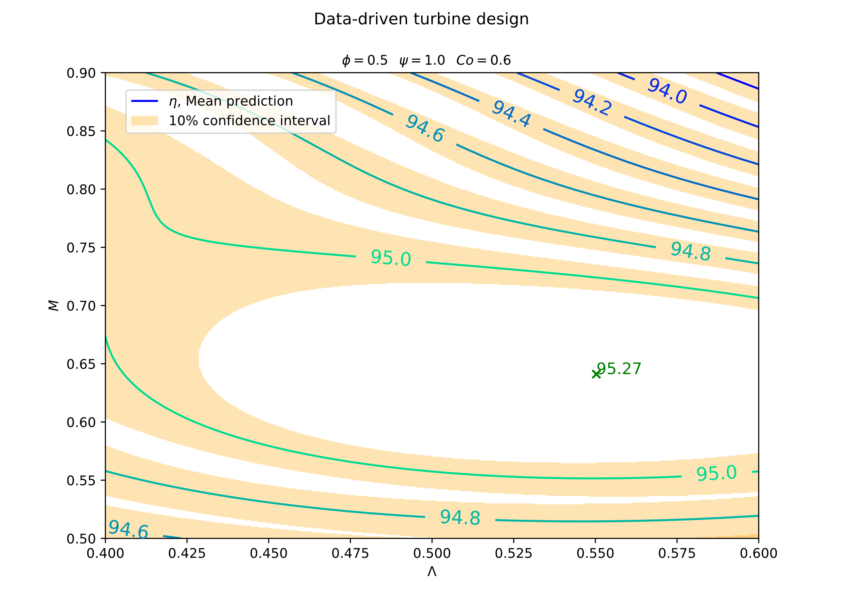
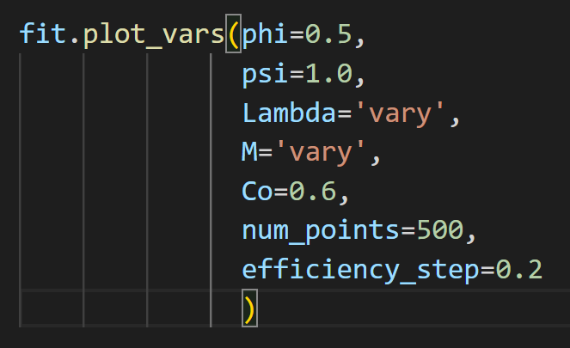
plot_vars (examples)

Slide 18
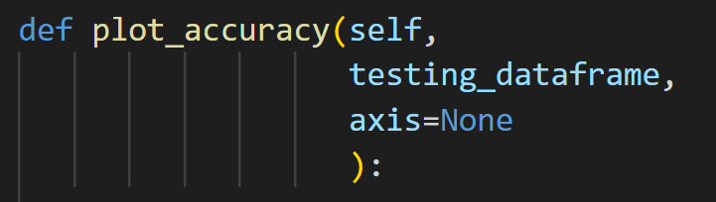
plot_accuracy

Slide 19
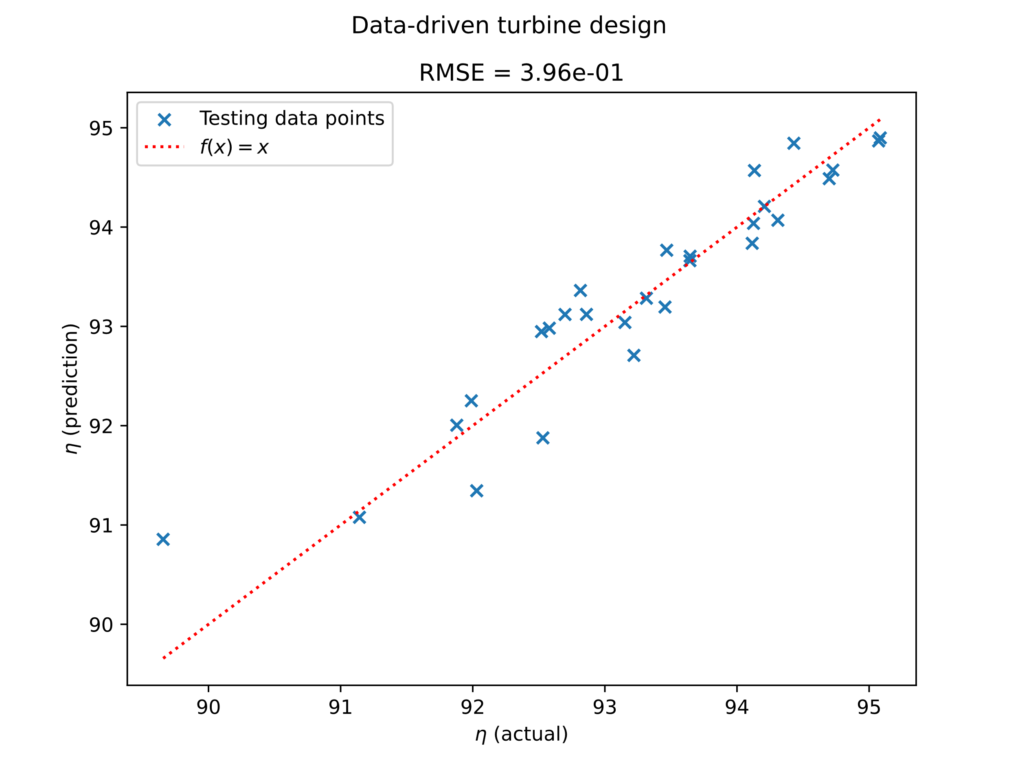
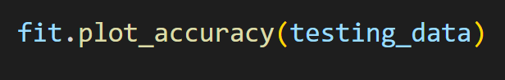
plot_accuracy (example)

Slide 20
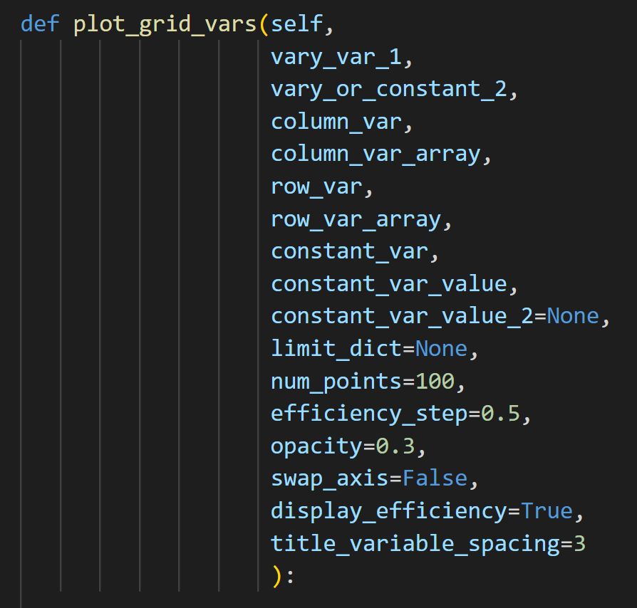
plot_grid_vars

Slide 21
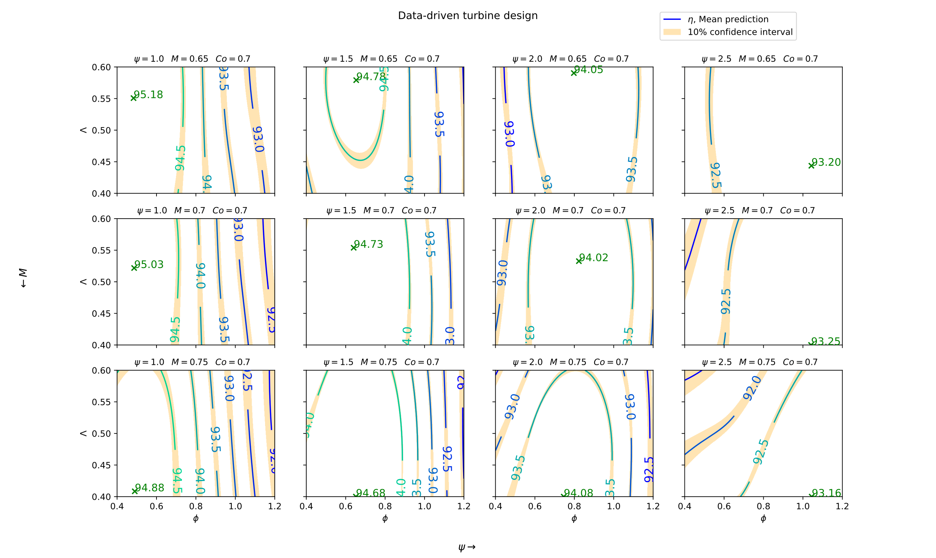
plot_grid_vars (examples)

